Slide 1
Cross-Platform Mobile Application Development with Xamarin
Module 3, Lesson 14:
Getting Your Apps into the App Store
Notes:
Images and excerpts from Xamarin Mobile Application Development by Dan Hermes, published by Apress
http://www.mobilecsharpcafe.com/xamarin-book/

Slide 2
Topics
Purpose of app stores
App store submission requirements
Versioning apps
Automation

Slide 3
Objectives
By the end of this lesson you should know:
Why app stores are used for application distribution
How to submit an app to major app stores
How to meet app store submission requirements

Slide 4
Why App Stores?
App stores provide a central location for curated apps
Digital distribution platform for applications for a device type
Users can search or browse for apps in app store
Users can download and install apps from app store
App stores can put restrictions on apps for quality and/or safety
Notes:
Notes:
Each device type (iOS, Android, Windows, etc.) has its own store
Users can filter apps by things like category of app, popularity, rating, price (can be free), etc.
Users can typically find out information about apps in the app store such as when the app was released, version number, how many people have downloaded it, read reviews, etc.
App stores typically have quality and/or security requirements for apps submitted to their stores. These will be briefly touched in future slides on each individual app store
Apps can be installed without an app store, but most users will start their search for apps in the app store. Thus, it would be a good business decision to get your apps that are intended for public consumption into the app store. This lesson will only discuss publishing apps to the app stores

Slide 5
Where’s the Money?
Marketing tools (no money)
App purchase price
Subscriptions
In-app purchases
Ads
Notes:
Notes:
Many apps are developed with no intention of generating revenue. They act as a marketing tools, like a website. A good app can engage a customer more deeply with its brand, which has indirect returns.
Generating revenue with an app can be done in one of several ways. Many apps are free, but the purchase price can be more than zero, generally $3-10 for a decent app, $1 for a cheap one, and $10-$30+ for specialized, sophisticated software. Subscriptions are a way to bill users for regular use of the service the app provides, often after a free trial period. After an app is installed and run, offers can be made by the app for additional purchases, called in-app purchases. Games are famous for this type of purchase, offering advantages for gameplay. Advertising is an important revenue generator for many apps. App audiences are offered to advertisers as targeted ad networks.

Slide 6
Submitting to the Apple App Store

Slide 7
Apple’s App Store: Steps
Generate distribution certificate
Create application identifier (AppID)
Generate distribution provisioning profile
Assign identity, sign app with certificate
Generate app package
Upload app package to iTunes Connect
Notes:
Notes:
The following slides will explain the steps on this slide
References:
iOS app distribution for Xamarin: https://developer.xamarin.com/guides/ios/deployment,_testing,_and_metrics/app_distribution/

Slide 8
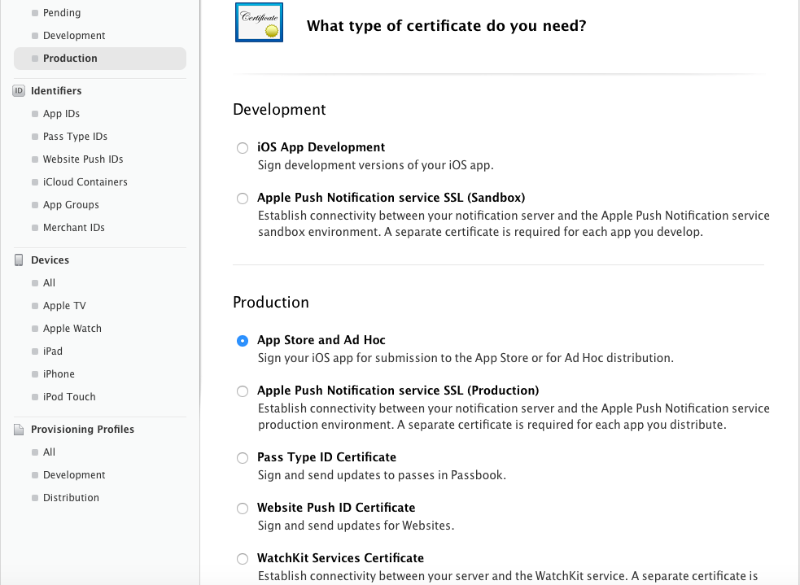
Distribution Certificate
Distribution certificates identify who you are to the app store
Go to developer.apple.com
Click Account
Go to certificates, identifiers and profiles
Select certificates > production
Click the + button
Select production > app store and ad hoc
Follow on-screen instructions to generate
Double-click generated certificate to install
Notes:
Notes:
At this point, a developer would already have an account in order to develop and test their iOS app
Only Team Agents and Admins can create distribution certificates. More on Team Roles and Privileges: https://developer.apple.com/library/ios/documentation/IDEs/Conceptual/AppDistributionGuide/ManagingYourTeam/ManagingYourTeam.html#//apple_ref/doc/uid/TP40012582-CH16-SW10
References:
Image source: https://developer.xamarin.com/guides/ios/deployment,_testing,_and_metrics/app_distribution/app-store-distribution/Images/CreateCertManually01.png

Slide 9
Application ID (AppID)
AppIDs identify the app that is to be distributed
Go to developer.apple.com
Click Account
Go to certificates, identifiers and profiles
Select identifiers > app ids
Click the + button, type a name
Type an app id
Select needed app services, click continue
Follow on-screen instructions to generate
Notes:
Notes:
At this point, a developer would already have an account in order to develop and test their iOS app
After entering an app id, you will need to select which app services will be required by your app. This determines what your app can access on an installed device
References:
Image source: https://developer.xamarin.com/guides/ios/deployment,_testing,_and_metrics/app_distribution/app-store-distribution/Images/CreateCertManually01.png

Slide 10
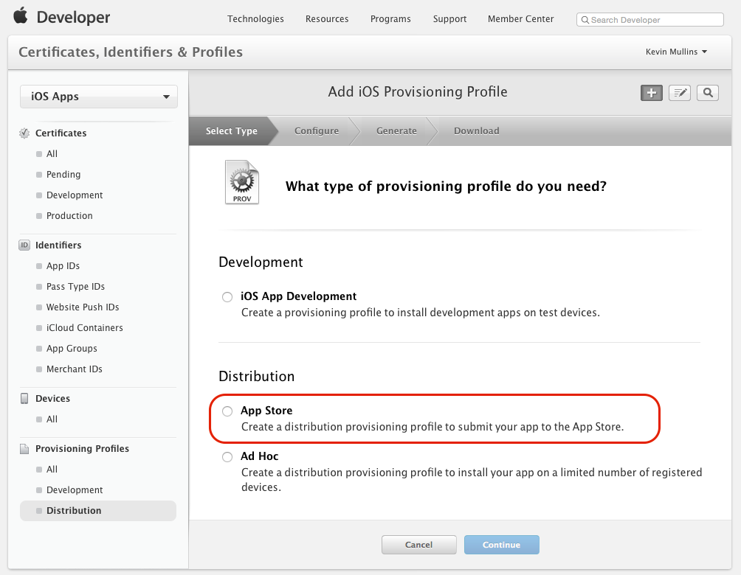
Distribution Provisioning Profile
Allows you to digitally sign apps so they can be installed
Go to developer.apple.com
Click Account
Go to certificates, identifiers and profiles
Select provisioning => distribution
Click the + button
Select distribution => app store, click continue
Follow on-screen instructions to generate
Notes:
References:
Image source: https://developer.xamarin.com/guides/ios/deployment,_testing,_and_metrics/app_distribution/app-store-distribution/Images/Distribute02.png

Slide 11
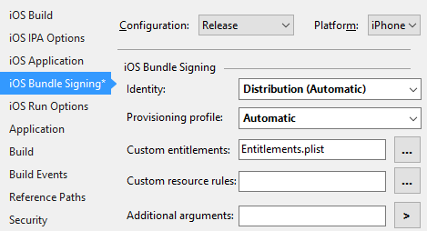
Using Provisioning Profile in Xamarin
Go to properties page of iOS project
Select iOS bundling signing
Select the release configuration
Select the proper platform
Select the distribution identity
Select the automatic profile
Notes:
Notes:
To get to the properties page of a project in Visual Studio, right click it in the Solution Explorer view and select properties. You can also left-click it and then hit alt + enter
For the distribution identity: if you have multiple available identities, you would select the correct one from the drop-down list
For the provisioning profile: if you have multiple available profiles, you would select the correct one from the drop-down list
For the purposes of this lesson, the custom entitlements and resource rules, as well as the additional arguments, will be left for further research for advanced use cases

Slide 12
iTunes Connect
Tools for developers to submit and manage their App Store apps
Provide screenshots or video of app in action on iOS devices
Provide app description with features, benefit to end user
Provide contact, support URLs to your site (required by Apple)
Set app's rating for parental controls in App Store
Select price or specify that app will be free
Notes:
Notes:
At this point, a developer would already have an account in order to develop and test their iOS app
There are more ways to configure the app. Most unlisted are very straight-forward (like the app’s name or an icon to show in the store, etc.)
The fine details in configuring iTunes Connect are outside of the scope of this lesson
References:
Apple’s reference guide for iTunes Connect: https://developer.apple.com/library/ios/documentation/LanguagesUtilities/Conceptual/iTunesConnect_Guide/Chapters/About.html#//apple_ref/doc/uid/TP40011225-CH1-SW1

Slide 13
Prepare for App Store Distribution
Edit Entitlements.plist, Info.plist files if necessary
Press Start button to deploy to device
Deploy will fail because provisioning profile meant for app store
Create .zip file out of app bundle
Go to http://help.apple.com/itc/apploader
Select getting started => installing Application Loader
Follow instructions
Open Application Loader, click the “Deliver Your App” button, and select the .app.zip file when prompted.
Notes:
Notes:
If the provisioning profile created in this lesson is used, it can’t be deployed to a device. It’s meant for the app store. But we still do this to create the app bundle
The generated app bundle can be located at ~/Library/Caches/Xamarin/mtbs/builds/YourAppName/{project-guid}/output/Release/iPhone/YourAppName.app
There is another way to prepare the app for the App Store, but it involves changing the provisioning and may confuse beginners
You only need to download and install Application Loader once per machine
References:
In-depth look at the preparation steps: https://developer.xamarin.com/guides/ios/deployment,_testing,_and_metrics/app_distribution/app-store-distribution/publishing_to_the_app_store/
Using Application Loader: http://help.apple.com/itc/apploader/#/apdATD1E12-D1E1A1303-D1E12A1126

Slide 14
App Store Submission Requirements
Apple protects users and maintains quality via submission requirements
Child safety
App must be unique, useful or entertaining
Demo apps or test apps will typically get rejected
Notes:
Notes:
Generally speaking, these are the things they consider most. But they have a very long and extensive document explaining what may get your app rejected (see References below)
References:
Apple’s reference guide for App Store review guidelines: https://developer.apple.com/app-store/review/guidelines/

Slide 15
Submitting to Google Play
Notes:
Notes:
There are other Android stores, but Google Play is the most dominant

Slide 16
Google Play Submission: Steps
Create release build
Create private key
Sign the APK
Publish onto Google Play
Notes:
Notes:
The following slides will explain the steps on this slide
References:
iOS app distribution for Xamarin: https://developer.xamarin.com/guides/ios/deployment,_testing,_and_metrics/app_distribution/

Slide 17
Create Release Build
Fill out Android Manifest (app/package name, version, permissions…)
In the build tab of properties page, change configuration to “Release”
Rebuild the solution
Notes:
Notes:
To open the Android Manifest, open the properties pages and click on Android Manifest
There are a lot more configuration options that are outside the scope of this lesson
References:
In-depth look at the preparation steps: https://developer.xamarin.com/guides/ios/deployment,_testing,_and_metrics/app_distribution/app-store-distribution/publishing_to_the_app_store/
Using Application Loader: http://help.apple.com/itc/apploader/#/apdATD1E12-D1E1A1303-D1E12A1126

Slide 18
Create Private Key
Use keytool to create a keystore:
keytool was installed when Android was installed
Keystore: database of security certificates for signing Android apps
$ keytool -genkey -v -keystore <filename>.keystore -alias <key-name> -keyalg RSA -keysize 2048 -validity 10000
Command prompt will ask a series of questions
Notes:
Notes:
Change <filename> and <key-name> to your proposed file name and key names
A sample of the command prompt’s questions will appear on the next slide
References:
Keytool documentation: http://docs.oracle.com/javase/6/docs/technotes/tools/solaris/keytool.html

Slide 19
Keytool Generation Sample
$ keytool -genkey -v -keystore a.keystore -alias a -keyalg RSA -keysize 2048 -validity 10000
Enter keystore password:
Re-enter new password:
What is your first and last name?
[Unknown]: Ham Chimpanze
What is the name of your organizational unit?
[Unknown]: NASA
What is the name of your organization?
[Unknown]: NASA
What is the name of your City or Locality?
[Unknown]: Cape Canaveral
What is the name of your State or Province?
[Unknown]: Florida
What is the two-letter country code for this unit?
[Unknown]: US
Is CN=Ham Chimpanze, OU=NASA, O=NASA, L=Cape Canaveral, ST=Florida, C=US correct?
[no]: yes
Generating 2,048 bit RSA key pair and self-signed certificate (SHA1withRSA) with a validity of 10,000 days
for: CN=Ham Chimpanze, OU=NASA, O=NASA, L=Cape Canaveral, ST=Florida, C=US
Enter key password for <publishingdoc>
(RETURN if same as keystore password):
Re-enter new password:
[Storing xample.keystore]
Notes:
Notes:
All of the text after prompts are examples of user input
Passwords are not displayed, even placeholders (like circles). This prevents others from knowing the length of the password
To list keys in a keystore, enter the following at a command prompt: keytool -list -keystore <MyKeyStore>.keystore, with MyKeyStore replaced with your keystore’s name

Slide 20
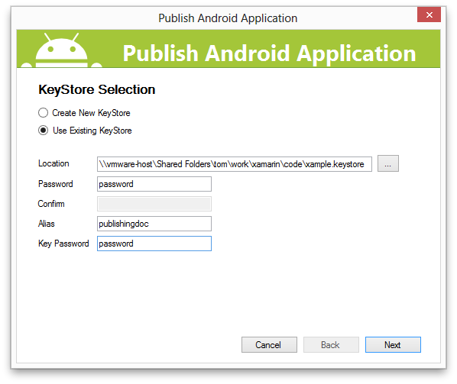
Sign the APK
Change the build configuration to release
Select tools > Android > publish Android app…
Complete form
Click Next
Notes:
Notes:
This build configuration is the one on the toolbar, not in the Android Manifest
References:
Image source: https://developer.xamarin.com/guides/android/deployment,_testing,_and_metrics/publishing_an_application/part_2_-_signing_the_android_application_package/Images/09.png

Slide 21
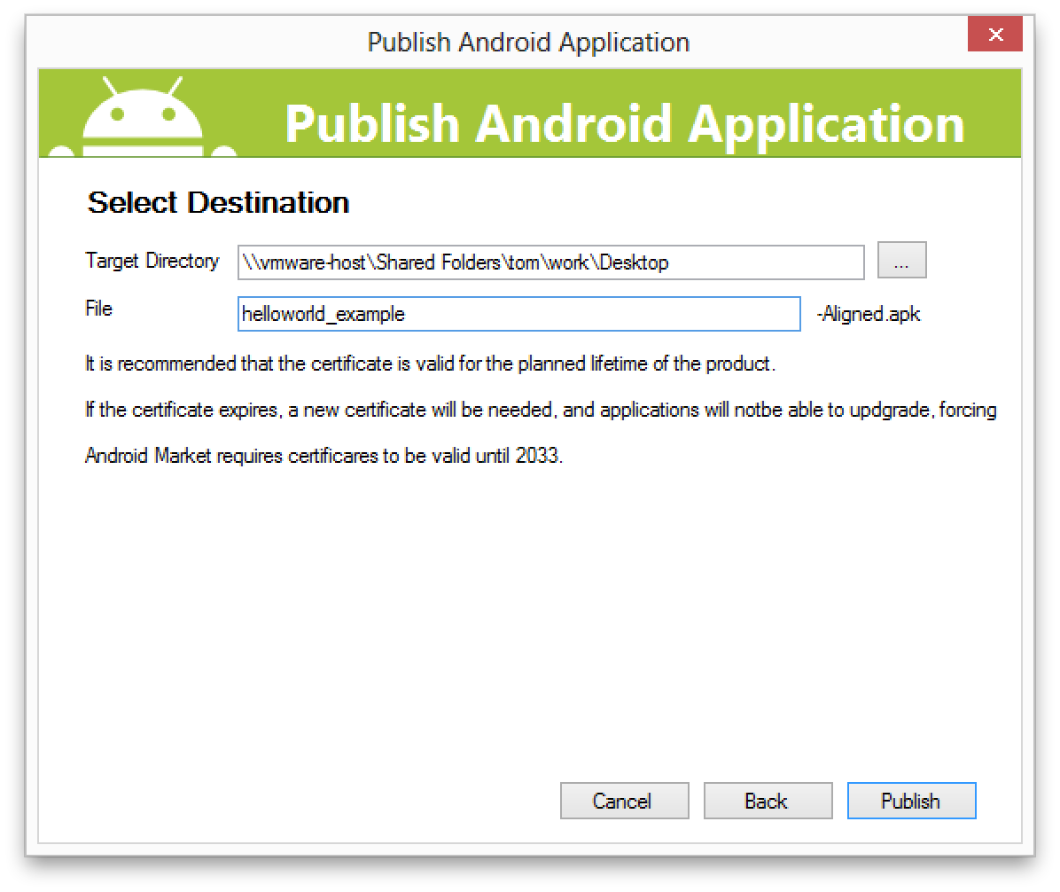
Sign the APK: Select Destination
Complete form
Click publish
Notes:
Notes:
This step will name the signed APK and destination of the generated, signed APK
References:
Image source: https://developer.xamarin.com/guides/android/deployment,_testing,_and_metrics/publishing_an_application/part_2_-_signing_the_android_application_package/Images/10.png

Slide 22
Prepare for Google Play Distribution
Register at https://play.google.com/apps/publish/signup/
Create images: launch icon, application icons, 2-8 screenshots
Go to https://play.google.com/apps/publish/
Select all applications > add new application
Select a language and name for your app
Select upload APK
Choose production
Select upload your APK
Notes:
Notes:
Only need to register once. $25 fee required
Launch icon is displayed on Google Play. Should have one for each major screen size: 36 x 36 px, 48 x 48 px, 72 x 72 px, 96 x 96 px
Application icon is for display in Google Play at a much larger scale. Must be 512 x 512 px
Screenshots must be 320w x 480h or 480w x 800h or 480w x 854h. At least two are required. Eight is the maximum allowed
There are other options for uploading images and videos showcasing your app. Only the required images were discussed
References:
In-depth look at the preparation steps: https://developer.xamarin.com/guides/ios/deployment,_testing,_and_metrics/app_distribution/app-store-distribution/publishing_to_the_app_store/
Using Application Loader: http://help.apple.com/itc/apploader/#/apdATD1E12-D1E1A1303-D1E12A1126

Slide 23
Google Play Submission Policies
Google protects users and maintains quality via submission requirements
Restricted content
Intellectual property, deception and spam
Privacy and security
Monetization and ads
Store listing and promotion
Notes:
Notes:
These are the categories of things they consider when judging an app submission. But they have a very long and extensive document explaining what may get your app rejected (see References below)
References:
Google Play developer program policies: https://play.google.com/about/developer-content-policy.html?rd=1

Slide 24
Submitting to Windows Store

Slide 25
Windows Store Submission: Steps
Configure app package
Create an app package
Validate app
Upload to store
Notes:
Notes:
The following slides will explain the steps on this slide

Slide 26
Configure App Package
Open Package.appxmanifest file in UWP project
Application tab: name, description, supported orientations, etc.
Visual assets tab: images, icons, logos
Capabilities tab: permissions
Packaging tab: display name, version, publisher, etc.
Notes:
Notes:
There are other options in the application tab, but these are the straight-forward, required ones
There are a lot of visual assets, like other device types. Visual Studio’s Package.appxmanifest designer gives information of all the sizes needed
Permissions of the app pertain to what device features the app can access
There are other, optional tabs that are outside the scope of this lesson
References:
In-depth look at the preparation steps: https://msdn.microsoft.com/library/windows/apps/xaml/hh454036(v=vs.140).aspx

Slide 27
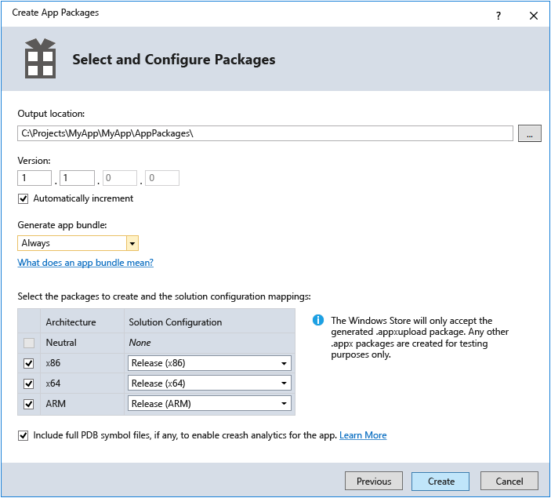
Create App Package
Right-click UWP app in Solution Explorer view
Select store => create app packages
Click yes and then next
Sign into developer account
Pick a name for your package
Fill out form
Click create
Notes:
Notes:
After clicking create, a new dialog will open. It will be explained in the next slide
References:
Image source: https://i-msdn.sec.s-msft.com/dynimg/IC826964.jpeg

Slide 28
App Validation
Microsoft protects users and maintains quality via app validation
Upon app create, app validation dialog opens
Choose machine to run validation
Click launch Windows app certification kit
When it passes, it’s ready to publish to the store
Notes:
Notes:
After the package has been created, a new dialog opens for app validation
References:
Google Play developer program policies: https://play.google.com/about/developer-content-policy.html?rd=1

Slide 29
Publish to Windows Store
In Visual Studio:
Select project menu => store => upload app packages
Sign in to Store
Dashboard opens
Choose Submit a new app, follow instructions on screen
Notes:
Notes:
Only need to register once. $19 fee required

Slide 30
A Successful Submission

Slide 31
App Submission Info
App Name
Pricing
Publish Date
App Description
Content Rating (Maturity)
Country(s)
Targeted Device types/sizes
App Icon
Notes:
Notes:
Apple App Store Review Guidelines
https://developer.apple.com/app-store/guidelines/
Icon: https://developer.apple.com/ios/human-interface-guidelines/graphics/app-icon/
Android
https://developer.android.com/distribute/tools/launch-checklist.html
Icon: https://developer.android.com/guide/practices/ui_guidelines/icon_design_launcher.html
Windows
https://developer.microsoft.com/en-us/store/publish-apps

Slide 32
How to Satisfy Your App Reviewers?
Minimize
Crashes and bugs
Memory consumption
Power consumption
Review OS data storage guidelines for files and folders and handle these different types of data accordingly
User-generated
Downloaded
App-generated
Temporary
Notes:
Notes:
Apple App Store Review Guidelines
https://developer.apple.com/app-store/guidelines/
Android
https://developer.android.com/distribute/tools/launch-checklist.html
Windows
https://developer.microsoft.com/en-us/store/publish-apps

Slide 33
What Do The Reviewers Look For?
Professional-looking apps
Original apps (not copycats)
Human Interface (UI) Guidelines
Kid-aware apps (help keep the store environment appropriate)
Notes:
Notes:
There are lots of kids in the app store. Develop accordingly.

Slide 34
Bottom Line: You Can Do It
Make a great app
Submit it
If it gets rejected, listen to the feedback carefully and redevelop
Submit again
Get accepted and watch your app user base grow!
Notes:
Notes:
Only need to register once. $19 fee required

Slide 35
Summary
After completing this lesson, you should understand:
Why app stores are used for application distribution
How to submit an app to major app stores
How to meet app store submission requirements

